Slide 1
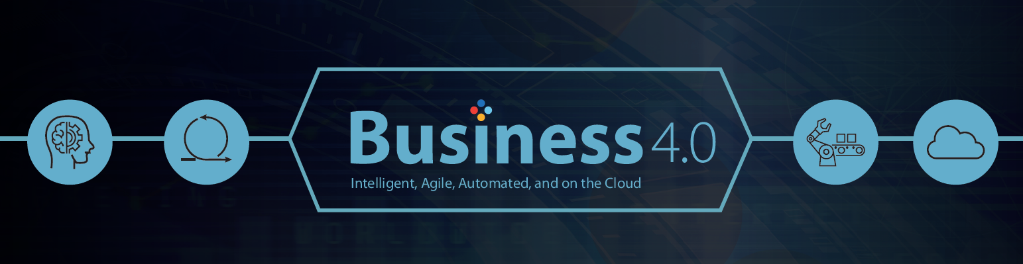
Understanding Business 4.0

Slide 2
Contents
  Evolution of Industry
  Digital Age
  What Business 4.0 means to Enterprise Organizations
    Optimizing Scarce Resources
  What are the opportunities of Business 4.0
    Where to Turn AI and Automation Loose in Your Company
    Why Your Products Must Be Smart and Connected
    Now You Can Simulate Nearly Anything
  How to pursue the opportunities
    What Happens When You Turn Your Products Into Services
    Why Agile Software Development Requires Radical Changes in Budgeting and Scoping
    Raising Your IoT Security Game
    The Big Opportunities at the Junction of AI and Analytics
  What is Business 4.0 & Why ?
  Industrial Use Cases
  TCS in action towards Business 4.0
  References

Slide 3
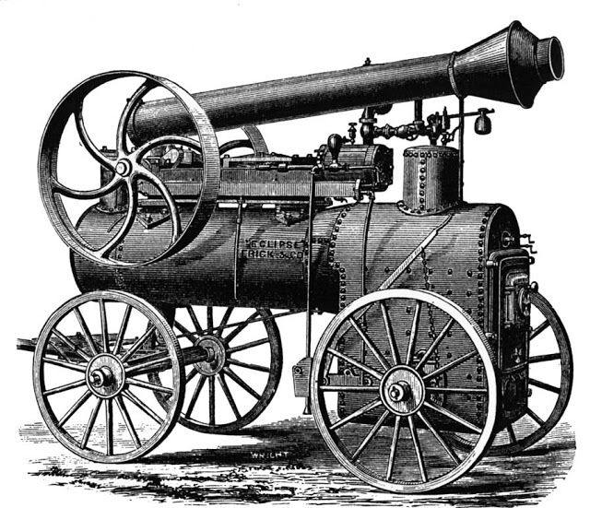

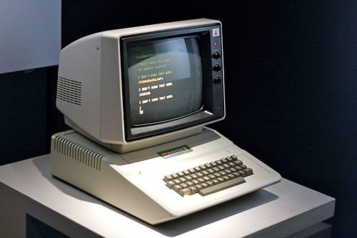

  Evolution of Industry
1.0 STEAM AGE (1770 and 1914)
2.0 AGE OF ELECTRICITY (During 19th & 20th Century)
3.0 COMPUTER AGE (During 20th Century)
4.0 Digital Age (21th Century)

Slide 4
  Evolution of Industry
1.0 STEAM AGE (1770 and 1914)
2.0 AGE OF ELECTRICITY (During 19th & 20th Century)
3.0 COMPUTER AGE (During 20th Century)
4.0 Digital Age (21th Century)

Slide 5
Digital Age ?
The digital revolution clearly erasing the boundaries of one industry from another in sector after sector.
For instance, Siemens and Volkswagen has built smart industries, each component or device is powered by advanced digital technological possibilities such as Ipv4, Ipv6 and RFID tag etc.
  RFID tag contains details of the device like Description, Status, Unique etc.
  Machine-to-Machine communication is possible using the current Digital technologies.
Each Device is Intelligent & Smart
  Devices/ Components in the digital world are Self- adoptive, self-aware, self-predict and self-compare

Slide 6
  What Business 4.0 means to enterprise organizations
2. Creating Exponential Value
The possibility of a step-change in value creation reflects, customer demand for the best products, world-class service, instantaneous delivery, and incredible price points.
1. Mass Personalisation
Business 4.0 promises greater segmentation, where organizations are able not only to identify a segment of one, but go beyond the individual.
3. Leveraging Ecosystems
The ability to deliver across a wide customer base and the ability to drive exponential value depends on the ability to deliver across the ecosystem. Businesses must start thinking about their entire supply and value chain as something they must influence.
4. Embracing Risk
The preference for the tried and tested and the risk-mitigation mindset needs to change 180 degrees to that of “embracing risk” and “adapt and transform continuously”, enabling businesses to not only respond to threats, but also deliver new business capabilities faster.

Slide 7
  Optimizing Scarce Resources
Abundance of Capital
Un-imagined pools of capital exist for those organizations that can paint a vision of what future looks like, have the strength of Character and boldness of leadership to execute on that task.
Abundance of Capabilities
By re-imagining the wider organizational environment and rethinking the relationships within it, enterprises can unlock the capabilities of their entire ecosystem.
Abundance of Talent
There are enormous skilled talent pools that could be crowd sourced and utilized on-demand. To take advantage, enterprises have to embrace the idea of blurred organizational boundaries where old definitions of “who is” and “who isn't” an employee are challenged.
Technological Platforms
The key factor is the technological platforms that give companies the ability to harness these abundant resources in real-time. The convergence of intelligence, agility, automation, and cloud has allowed for the creation of technology platforms to effectively harness this abundance.

Slide 8
  What are the opportunities of Business 4.0
Where to Turn AI and Automation Loose in Your Company
Industrial-strength AI is ready for deployment. But one of the biggest challenges for large companies is determining where to use it. Although the possibilities are endless, companies’ budgets, of course, are not. Ashok Pai and Krishna Mohan give executives a way to identify the best places to use AI in their organizations.
Why Your Products Must Be Smart and Connected
In the last few years, strategy experts like Harvard Business School Professor Michael Porter have been urging industrial companies to embed their products with digital sensors and wireless devices that report back on how they’re functioning in the field. Making products smart and connected is no longer an option; it’s a necessity.
Now You Can Simulate Nearly Anything
Suppliers of public cloud computing services such as Amazon Web Services, Microsoft, and Google represent a powerful capability that many companies don’t realize they now have: to simulate strategies, product and service concepts, and new business processes at affordable prices. In their article, PR Krishnan, Satishchandra Doreswamy, and Suranjan Chatterjee explain why this is so important today, and seven applications of simulations that promise big benefits. To illustrate each one, they point to examples at Kellogg, Aon Benfield, GE, and HSBC, among other companies.

Slide 9
  How to Pursue the Opportunities
What Happens When You Turn Your Products Into Services
So you’ve decided to make your products ‘smart and connected’. How do you then play in the ‘servitization’ game, the one in which you’ll generate revenue by offering your product as a service? In his article, Regu Ayyaswamy explains why the service opportunities are abundant: They turn what he calls ‘open-loop’ systems into ‘closed-loop’ ones—where a manufacturer no longer loses information to third parties on how its products are performing for customers. He examines four servitization opportunities for companies with closed-loop systems, and explains how to overcome significant obstacles that will stand in the way.
Why Agile Software Development Requires Radical Changes in Budgeting and Scoping
To stay competitive in this world of intelligent cloudbased products and services, big companies need to move as quickly as new companies. That means getting new digital products and processes up in weeks or months, not years. But that can’t be done if such systems are staged, funded, and scoped in the same manner of the enterprise systems of old. Companies must now rely on agile cross-functional teams that use agile software development methods. But that is harder than it sounds, and one of the biggest barriers is how agile programs are scoped and funded. In short, traditional systems budgeting and scoping methods can throw wrenches into the wheels of agile development. In their article, Nidhi Srivastava, Apala Mukherjee, and Somnath Ghosh provide an antidote to the all-too-frequent starts and stops of agile teams: a different way of scoping and budgeting these programs.

Slide 10
  Pursuing Opportunities
Raising Your IoT Cyber Security Game
By making their products smart and connected, manufacturers can transform themselves into service companies and generate new revenue. But they can also generate the attention of attackers to their new IoT-enabled products, as TCS IoT cyber security expert Satish Thiagarajan writes in his article. As he says, hacking incidents into IoT-enabled products in the U.S. Alone soared seven times between 2010 and 2015. And most computer networks should expect IoT security breaches next year, warns IDC. Thiagarajan outlines eight steps companies should take today to reduce the chances of becoming the next victim.
The Big Opportunities at the Junction of AI and Analytics: Interview with Tom Davenport
We are delighted to feature an Interview with Tom Davenport, a leading chronicler over the past 30 years on how information technology has radically transformed the work and very essence of large businesses around the world. Since the late 1980s, Davenport has been a pioneer of business process redesign/reengineering, business analytics, and other leading concepts. He has published several classic Harvard Business Review articles and bestselling books on the business value of enterprise systems, knowledge management, big data and analytics, and most recently AI. I think you’ll find Tom’s interview eye-opening, particularly his call for companies to stop focusing on using technology to get rid of people.

Slide 11
  Industrial Use Cases
Healthcare
Logistics and the Industrial Internet
Retail
Oil and Gas Industry:
The Oil and Gas industry depends on the development of high technology as well as scientific intelligence in the quest for discovery of new reservoirs. The exploration and development of newly discovered oil and gas resources requires modern sensors, analytics, and feedback control systems that have enhanced connectivity, monitoring, control, and automation processes

Slide 12
What is Business 4.0 & Why ?
1. We stand at, building digital spines and moving to the Cloud, embracing Automation with Agile practices and robotics with Artificial Intelligence (AI).
2. By offering Experience First, leading enterprises are winning over new customers and growing at a super accelerated pace.
We call this Business 4.0,
'Intelligent, Agile, Automated, and on the Cloud'
Why ?
It provides better visibility and insight into the company’s operations and assets through integration of machine sensors, middle-ware, software, and back-end cloud compute and storage systems.
Therefore, it provides a method of transforming business operational processes by using as feedback the results gained from interrogating large data sets through advanced analytics.

Slide 13
References
TCS PERSPECTIVES, Vol.10, by Krishnan Ramanujam, President, Business and Technology Services

Slide 14


